Slide 1
Predicting the Price of Russia Real State
Rakan S. Alnasser

Slide 2
Overview
Abstract
design
The goal of this project was to use Regression models to Predict the Price of Real state in Russia.
The project helps to find the right opportunities to get the best prices based on its features
Tools
Data
NumPy and Pandas for data manipulation
Scikit-learn and xgboost for modeling
Matplotlib and Seaborn for plotting
The dataset contains over 5 million real estate samples. The dataset has 13 fields,

Slide 3
Algorithms
Data Cleaning
Feature Engineering
Remove outliers
Drop the real state with no. of rooms = -2
Replace the no. of rooms with 0 instead of –1.
Drop unwanted columns.
Create a pivot table to add a new feature
MODELS
Linear regression
Degree 2 polynomial regression
XGB regressor

Slide 4

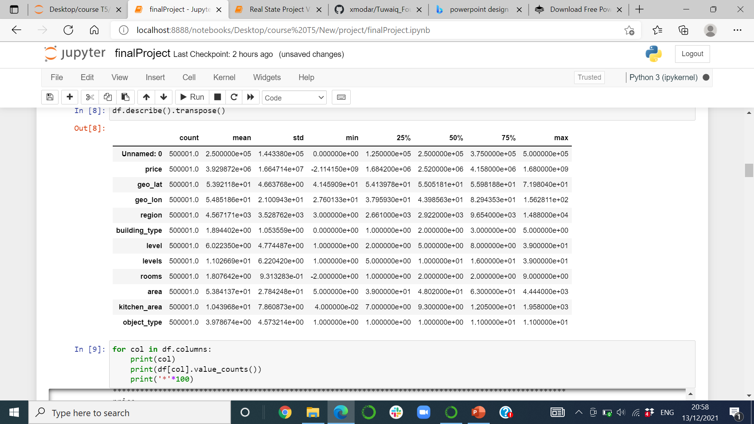

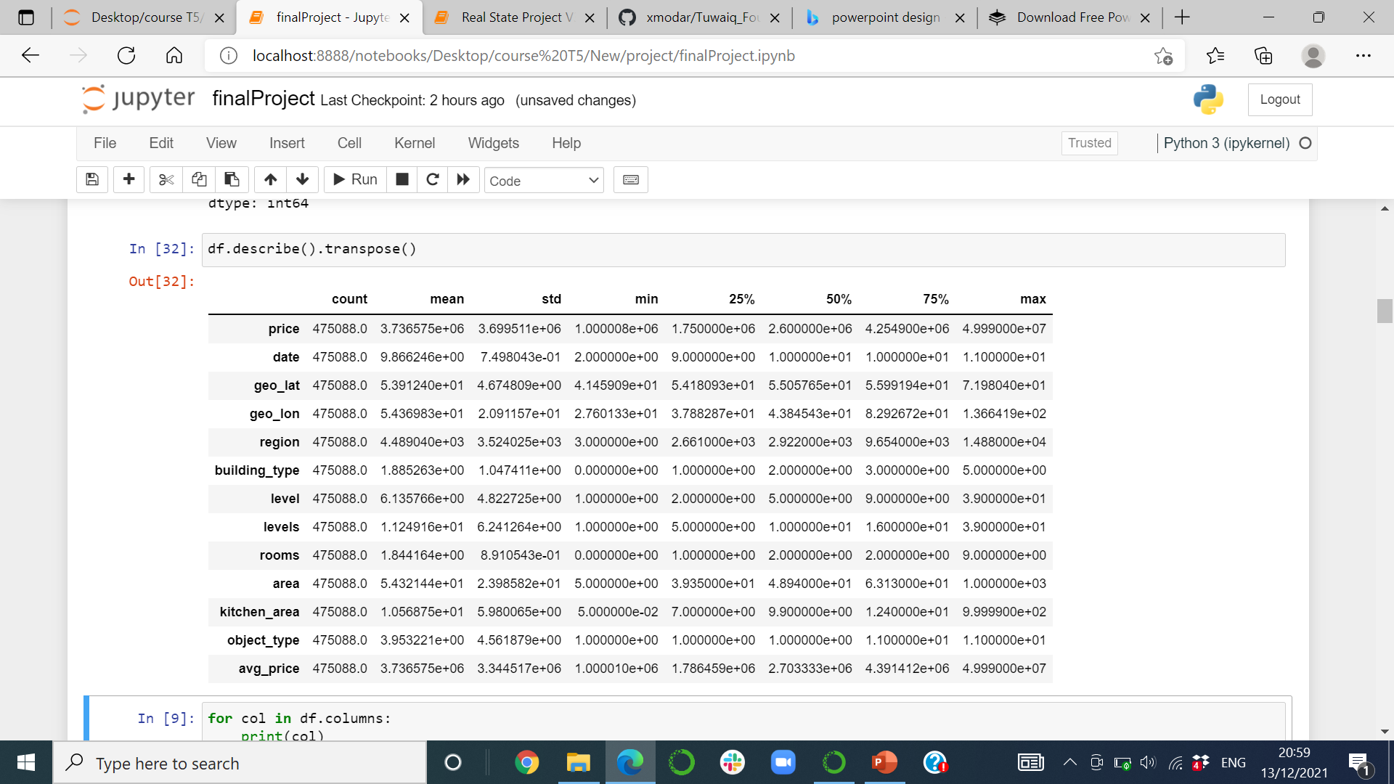
Describe()
Here I show you the describe() function before and after data cleaning
The new column is avg_price

Slide 5
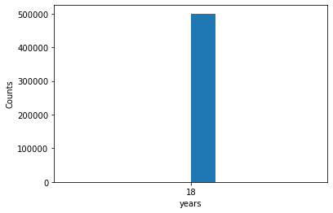
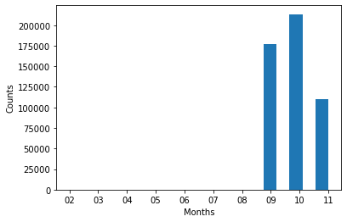
visualization

Slide 6
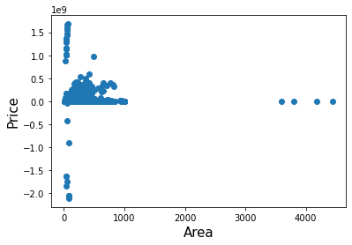
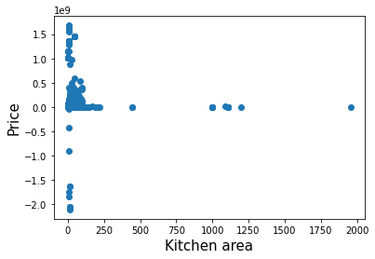
Outliers

Slide 7
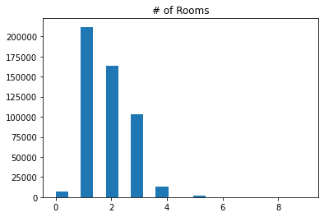
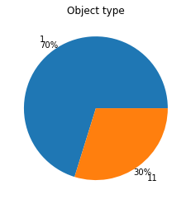
visualization

Slide 8
Models
Now we will evaluate the 3 models on validation data to select the best one to use it on the testing data
Linear Regression validate R^2: 0.853
Degree 2 polynomial regression validate R^2: 0.891
XGBRegressor validate R^2: 0.941

Slide 9
Conclusion
From the results in previous slide, we found that XGBRegressor model has the highest score so we will use it as our final model and apply it on test data as follows
XGBRegressor test R^2: 0.943

